Slide 1


MALINENI LAKSHMAIAH WOMEN’S ENGINEERING COLLEGE (Accredited by NBA(CSE&ECE), NAAC A+, Approved by AICTE,NEW DELHI , Affiliated to JNTUK, Kakinada)
Department of Information Technology
PLANT DISEASE DIAGNOSIS USING CNN:A MACHINE LEARNING APPROACH
UNDER THE GUIDANCE OF :
DR. A. S. R. K. Ratnam
M.E.(CSE), M.TECH.(CSE). PH.D(IP).,
TEAM MEMBERS :
B.YAMUNA (20KE1A1205)
S.TEJA SRI (20KE1A1254)
N.BHARATHI (20KE1A1245)
D.CHANDRIKA (20KE1A1211)

Slide 2
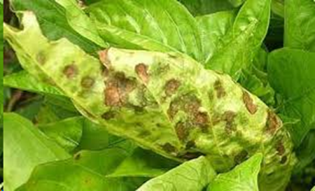
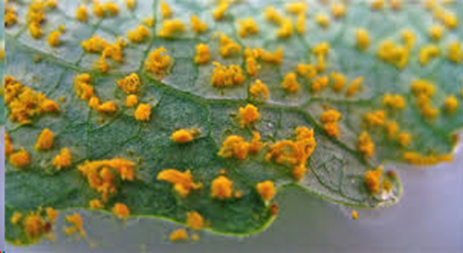
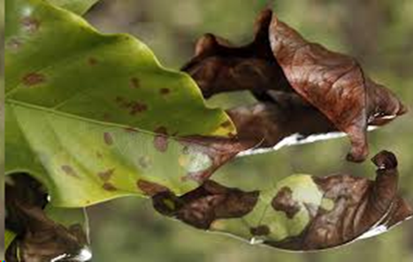
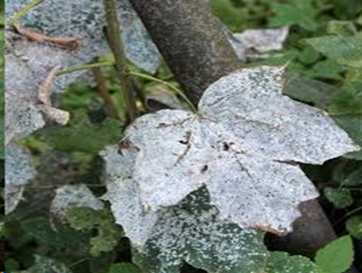
PLANT DISEASE DIAGNOSIS USING CNN: A MACHINE LEARNING APPROACH
BACTERIA
FUNGUS
RUST
VIRUS

Slide 3
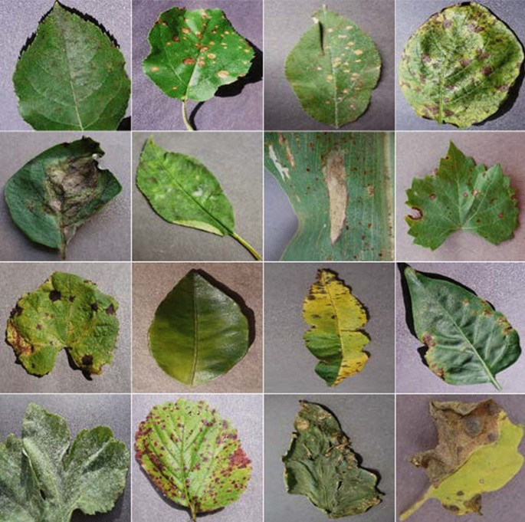
CONTENTS
ABSTRACT
INTRODUCTION
EXISTING SYSTEM
PROPOSED SYSTEM
SYSTEM REQUIREMENTS
DESIGN
PLANT DISEASES
DATASET TRAINING
CONCLUSION
REFERENCES

Slide 4
ABSTRACT
In the realm of agriculture, timely detection of plant diseases is crucial for ensuring crop health and Productivity. This project focuses on the development of an intelligent system for early detection and diagnosis of plant diseases by merging deep learning techniques, particularly Convolutional Neural Networks (CNNs), with traditional machine learning approaches. The system aims to provide farmers and agricultural experts with timely and accurate insights into the health status of their crops, enabling proactive disease management strategies to minimize crop losses and promote sustainable agriculture.
The project not only advances the field of plant pathology but also contributes to the development of robust and intelligent agricultural systems.

Slide 5
INTRODUCTION
India heavily relies on agriculture, with over 60% of its population engaged in farming.
Plant leaf disease detection using ML was introduced to tackle challenges related to limited knowledge of plant diseases.
Traditional ML techniques involve feature extraction and classification based on color, texture, and shape.
DL techniques like CNNs have been proposed for identifying subtle disease symptoms and handling high-resolution images effectively.

Slide 6
EXISTING SYSTEM
Manual methods for plant disease detection are subjective and time-consuming, lacking precision for large-scale agriculture.
Automated systems using machine learning, like CNNs, improve accuracy and efficiency in disease detection, complementing human expertise.
Automation offers real-time monitoring and supports timely decision-making for effective intervention and management of plant diseases.

Slide 7
DISADVANTAGES :
Limited Precision and Efficiency
Lack of Real-time Monitoring
Time-Consuming Process

Slide 8
PROPOSED SYSTEM
Integrates CNN (Convolutional Neural Network) and deep learning algorithms with machine learning principles.
CNN models are trained on extensive datasets of plant images.
Enables automatic learning and recognition of complex patterns associated with different plant diseases.
Results in a sophisticated and intelligent plant disease detection system.
Offers rapid, accurate, and scalable solutions for crop monitoring and management.

Slide 9
ADVANTAGES:
Accuracy
Speed
Improved Crop Management
Algorithms:
Mobilenet and Convolutional Neural Network.

Slide 10
SYSTEM REQUIREMENTS
Hardware Requirements:
Processor : 2.5 gigahertz (GHz) frequency
RAM : A minimum of 4 GB of RAM
Hard disk : A minimum of 20 GB
Input Device : High resolution camera
Monitor :Minimum Resolution 1024 X 768
Software Requirements:
Convolutional Neural Networks (CNN)
Deep Learning Frameworks (e.g., TensorFlow, Keras)
Machine Learning Libraries (e.g., Scikit-learn)
Image Processing Tools (e.g., OpenCV)

Slide 11
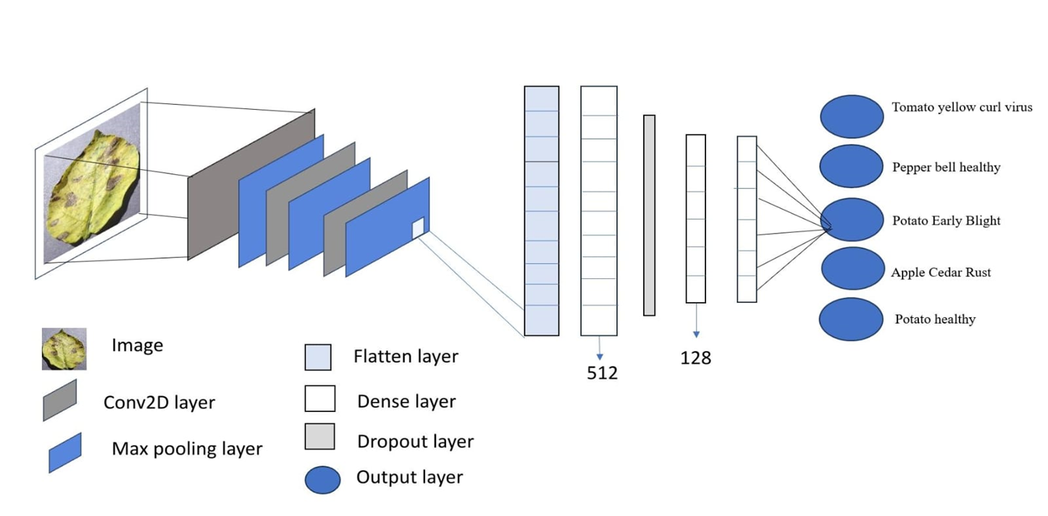
DESIGN
Figure : System Architecture

Slide 12
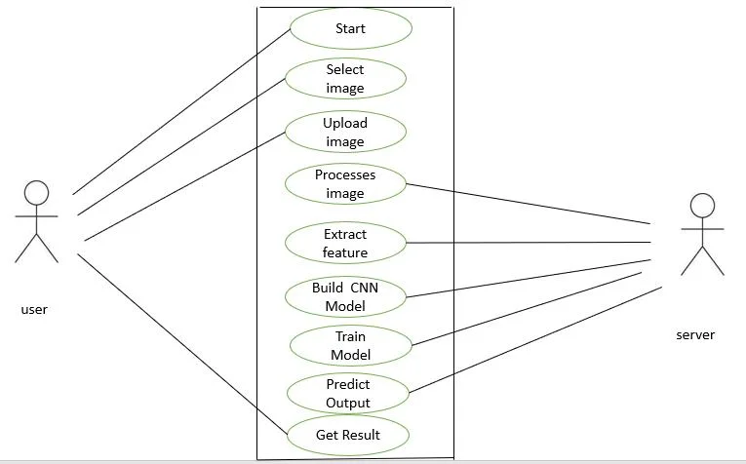
MODEL DESIGN FOR USER AND SERVER
Figure : Use Case Diagram

Slide 13
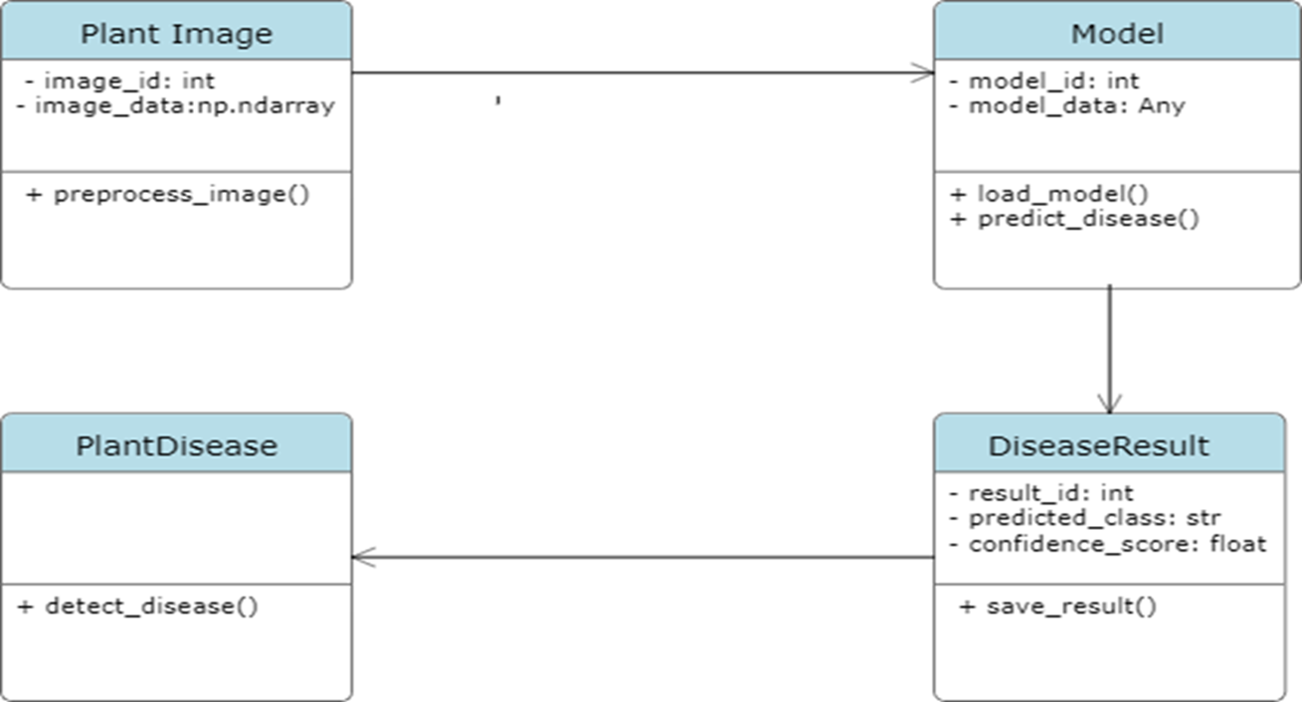
UML Diagrams
Figure : Class Diagram

Slide 14


PLANT DISEASES
Bacterial Diseases:
Cause: Bacterial diseases in plants are caused by various types of bacteria that infect plant tissues, leading to symptoms such as wilting, leaf spots, cankers, and rotting.
Transmission: Bacteria can enter plants through wounds, natural openings, or insect vectors. They can also be spread through contaminated tools, soil, or water.
Fungal Diseases:
Cause: Fungal diseases are caused by various types of fungi that infect plant tissues, leading to symptoms such as leaf spots, powdery mildew, rust, cankers, and damping-off.
Transmission: Fungi can spread through spores, air, soil, water, infected plant debris, and vectors such as insects or animals.

Slide 15


Rust Diseases:
Cause: Rust diseases are caused by specific types of fungi belonging to the rust fungi. These fungi infect plant tissues, leading to characteristic rust-colored pustules on leaves, stems, or fruits.
Transmission: Rust fungi produce spores that can spread through air currents, wind, rain, or human activities.
Viral Diseases:
Cause: Viral diseases in plants are caused by various types of viruses that infect plant cells, leading to symptoms such as mosaic patterns, yellowing, stunting, leaf curling, and necrosis.
Transmission: Viruses can be transmitted through infected plant material, insect vectors, nematodes, grafting, and mechanical means such as pruning tools or contaminated hands.

Slide 16
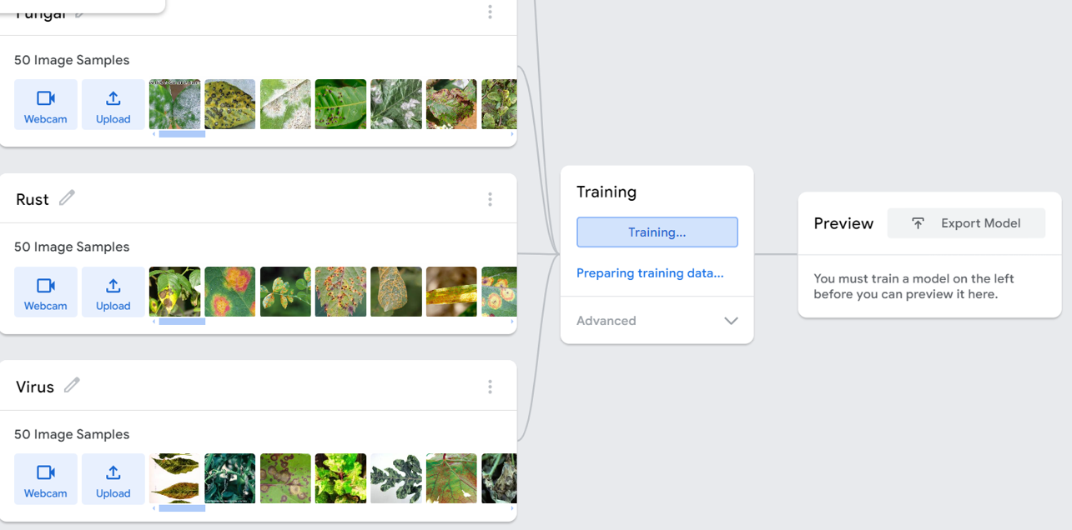
DATASET TRAINING

Slide 17
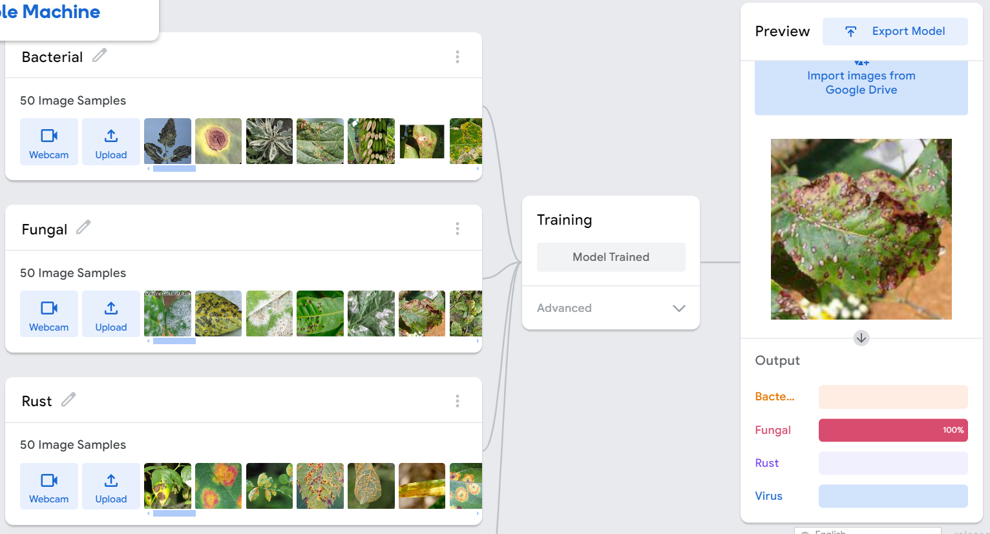
PREDICTING CONFIDENCE SCORE

Slide 18
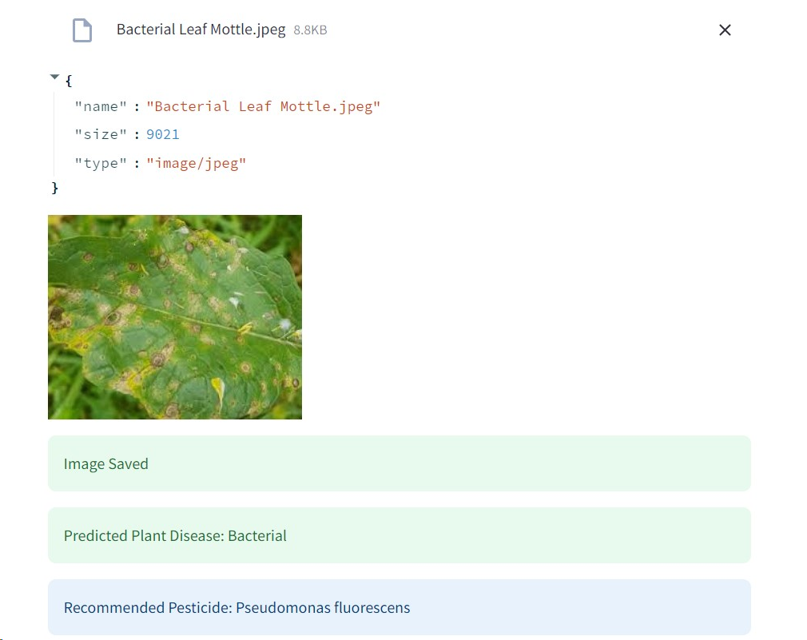
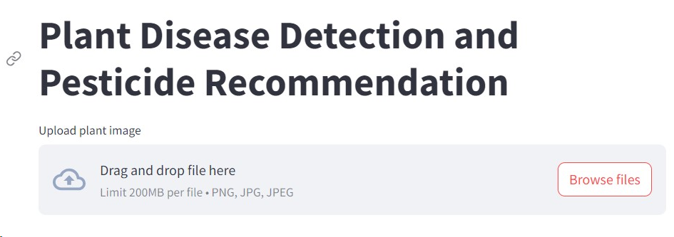
RESULT

Slide 19
CONCLUSION
Finally we conclude that the plant disease detection system using CNN and deep learning is a promising tool for better crop monitoring. It learns from a lot of plant images to quickly and accurately spot diseases. It can work for many different crops and diseases and is easy for farmers to use. Future improvements like detecting multiple diseases at once, monitoring in real-time, and adding a mobile app will make it even better. This system helps farmers manage crops better and can lead to higher yields, making it a big advancement in agriculture technology.

Slide 20
FURTHER ENHANCEMENT
In the future we would like to increase the accuracy and efficiency of our project by visualizing remaining errors and using further optimization techniques.
Developing a user-friendly mobile app for farmers to easily upload plant images for analysis and receiving instant feedback is also beneficial.

Slide 21
REFERENCE
G. Hughes, H. Witten, "Plant Disease Detection Using Deep Learning," International Conference on Pattern Recognition (ICPR), 2018.
M. Senthil Kumar, S. Elavarasan, "Plant Disease Detection Using Convolutional Neural Networks," International Journal of Innovative Technology and Exploring Engineering, vol. 8, no. 12S2, 2019
N. Singh, A. Gogoi,"Plant Disease Detection and Classification Using Deep Learning: A Comprehensive Review," IEEE Access, vol. 8, 2020
J. P. Hughes, M. A. Dick, "Plant Disease Recognition Using Deep Learning: A Review," Journal of Intelligent & Fuzzy Systems, vol. 41, no. 4, 2021.

Slide 22

J
THANK YOU

